Slide 1
INTRODUCTION
Hello and welcome to today’s presentation of which I am excited to take you through.

Slide 2
About data set
The dataset contains information on 1000 customer details, order and products of coffee from 2019 to 2022 from different countries.
For this project , I used excel to access the dataset, clean and perform Exploratory Data Analysis.
Below are the outline of the project:
Explore Dataset and perform Data Validation.
Data Cleaning.
Project Questions.
Solution and Answers.
Observations.
Recommendations.

Slide 3
ExplorING dataset and perform data validation
I explored the dataset which consist of 3 different tables customer_details, order, and product. I noticed the following
No duplicate found.
Irrelevant columns.
No outliers.
There was spelling error in some cells.
The date column is in a numeric format instead of date format.
There are blank cells in the email and phone number column.

Slide 4
Data cleaning
Correction of spelling errors found.
Change the date order column data type to date format.

Slide 5
Project Questions
Key Performance Indicators (KPIs)
Trend of Total Sales for Coffee Types:
Sales by County:
Top 5 Customers:
Total Quantity Ordered for Each Coffee Type:
Total Sales: Calculated and displayed the overall total sales as a key summary metric.
Total Quantity Ordered: Provided a summary of the total quantity ordered across all coffee types.
Years (Time Series): Implemented a user-friendly filter for selecting and analyzing data across different years.
Loyalty Cards: Allow users to filter data based on the presence or absence of loyalty cards.
Size: Provided a filter option to segment data by coffee size.
Roast Types: Included a filter for users to explore data based on different coffee roast types.

Slide 6
Solution and Answers
As mentioned earlier, the dataset consists of 3 different tables.
Using VLOOKUP function, I merge important column from customer_details table and products table to orders table needed to solve question that were asked.
I also use the IF function to replace abbreviate in coffee type column and roast type column to their full name. Where Rob is Robuster, Exc is Excelsa, Ara is Arabica and Lib is Liberica for coffee type while M is Medium, L is Light and D is Dark for roast type column.
I create a new column which I name “Sale” to calculate the sales made, by multiplying the Unit Price column with the Quantity column
In other to solve the above questions, I created pivot table and chart for each question.

Slide 7
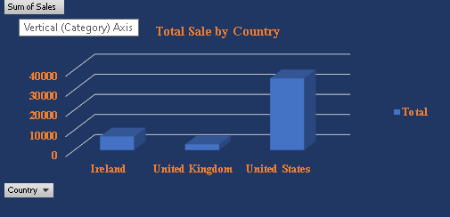
SALES BY COUNTRY
The above illustration show that United States made the highest sales of $35,639 followed by Ireland and United Kingdom with $6,697 and $2,799 respectively.

Slide 8
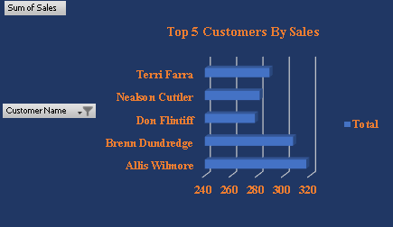
SALES BY TOP 5 CUSTOMERS
Generate a table or chart highlighting the top 5 customers based on their contribution to total sales.
These are the top 5 customers with the highest purchase. Customer ID was use in other to protect the customer’s real identity.

Slide 9
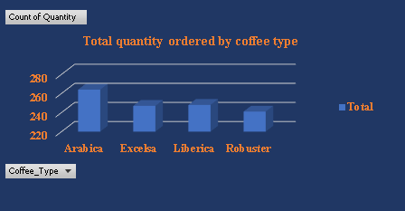
TOTAL QUANTITY ORDERED FOR COFFEE TYPES
Utilize a bar or pie chart to visually represent the quantity ordered for each coffee type.
From the above information, Arabica coffee type has the highest quality ordered of 947 and Liberica having the lowest quantity ordered of 854.

Slide 10
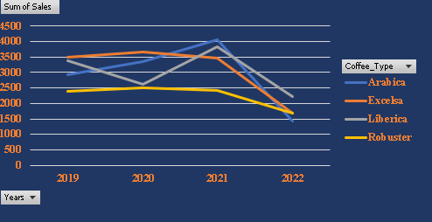
TREND OF SALES BY COFFEE TYPE
Develop a line chart illustrating the trend of total sales across different years for each coffee type.
From the pivot table and the line chart, it can be concluded that year 2021 has the highest sales of $13,766. Although year 2022 data was only collected from January to August, but comparing those months sales to that of 2022 January to August, it relatively low to that of 2021.
The other question were answered by constructing a complete interactive dashboard using timeline and slicer.

Slide 11
OBSERVATIONS
The total revenue generated from 2019 to 2022 was $45,134.
The total quantity ordered from 2019 to 2022 was 3,551.
2021 has the highest sales of $13,766.
The total number of customers that use loyalty card amount to 479 with total sales of $20,918 while those that didn’t use the loyalty card are 521 with total sales of $24,216.
The customer ID with the highest purchase is 27930–59250-JT while the customer ID with the highest purchase that use loyalty card is 86579–92122-OC.
Coffee size of 0.5 has the highest quantity ordered generating $7,030 while coffee size 2.5 has the lowest quantity ordered of 841 with the highest sales of $23,786. This shows that the bigger the size sold the more revenue generated.
The Light Roast type generates the highest revenue of $17,354 with the highest quantity ordered of 1,230 followed by Medium and Dark with revenue of $14,600 and $13,179 respectively.
United State has the highest sale of $35,639 while Ireland and United Kingdom have the sales of $6,697 and $2,799 respectively.

Slide 12
RECOMMENDATIONS
The management should create more awareness on loyalty card as some customers are not yet registered.
Create awareness on social media social, open social media account for the coffee shop and make adverts.
Ask for customer’s feedback in other to know the pros and cons of the business especially in United Kingdom and Ireland due to the low sales experienced.
Allow sales of other snacks and pastries for additional income for the business.
Stay friendly to customers.

Slide 13
THANK YOU MESHACH ABAIDOO QUANSAH

